Slide 1

Reservoir Park - washroom
Town Council Update
July 22, 2025

Slide 2
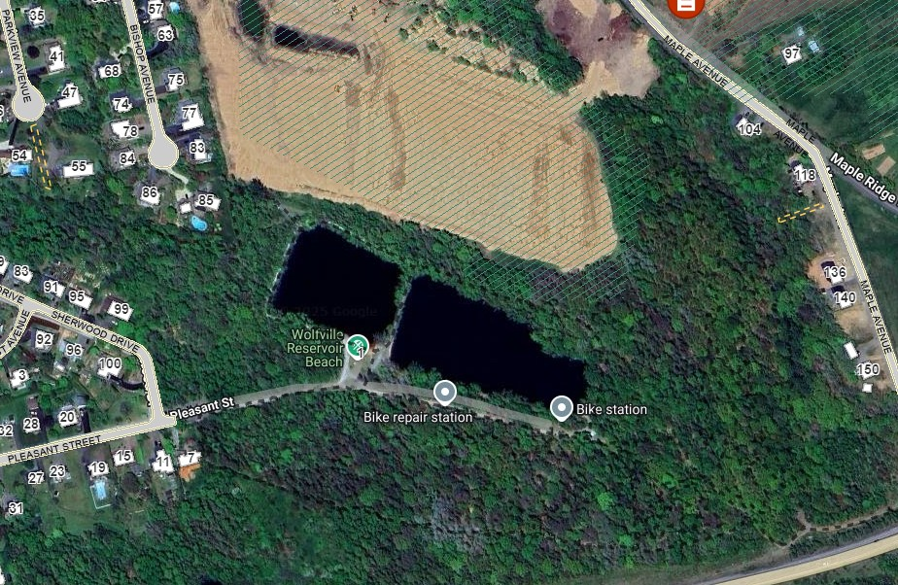

Slide 3
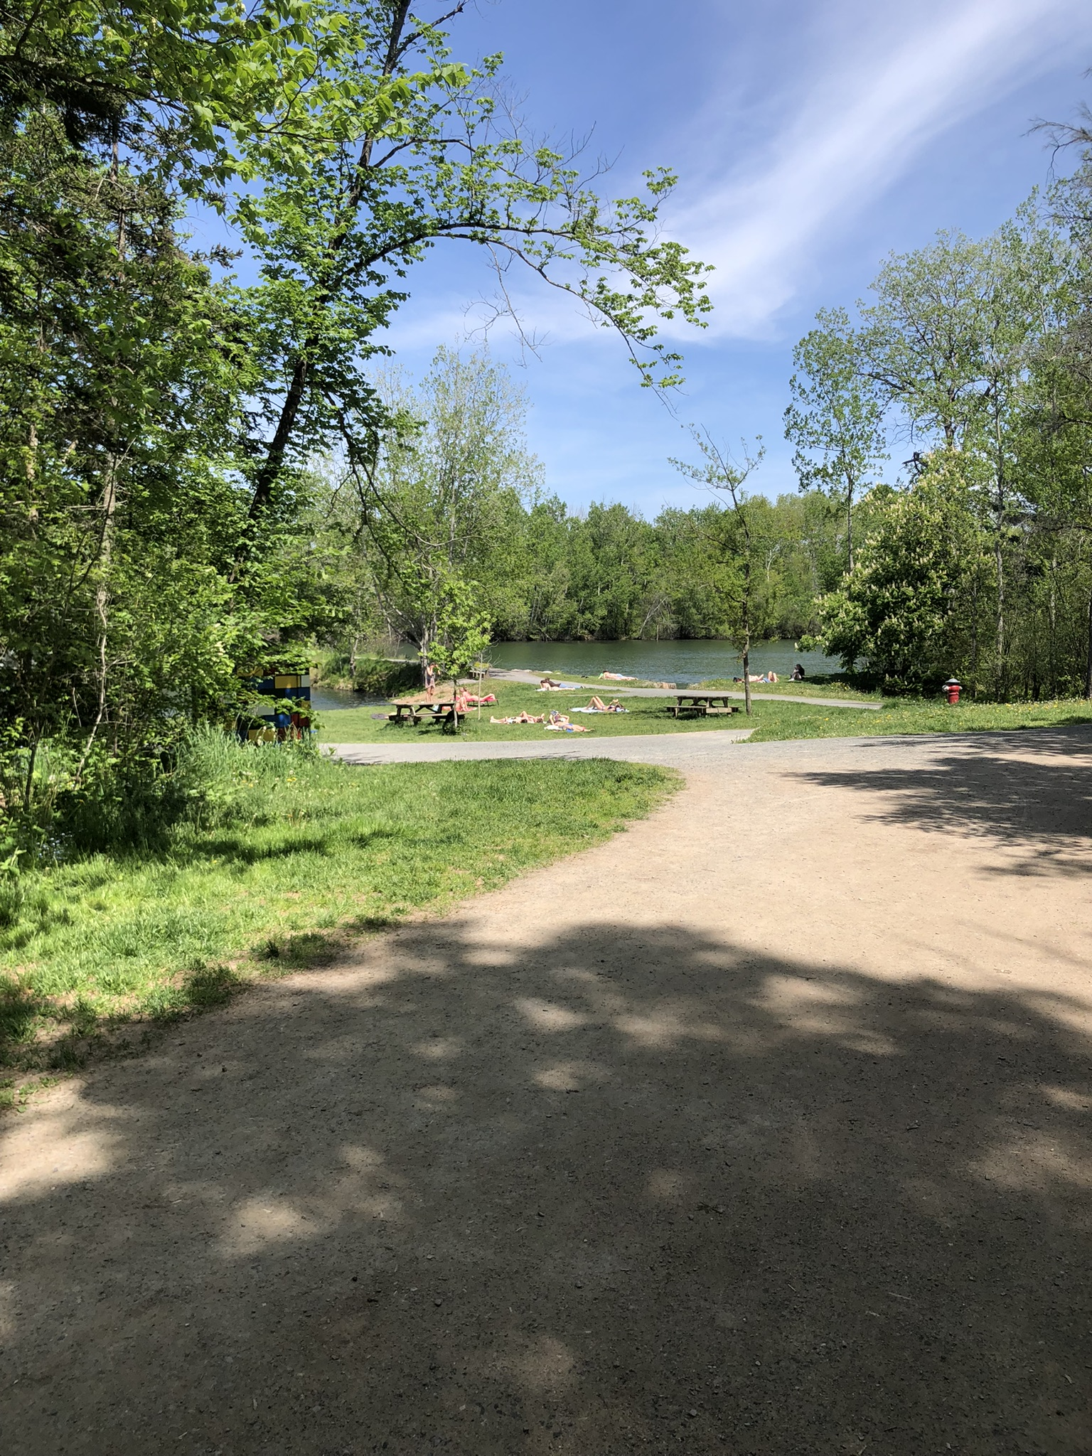
Reservoir Park
Beach
Swimming
Dog walking
Recreation
Biking
Beach
Swimming
Dog walking
Recreation
Biking

Slide 4
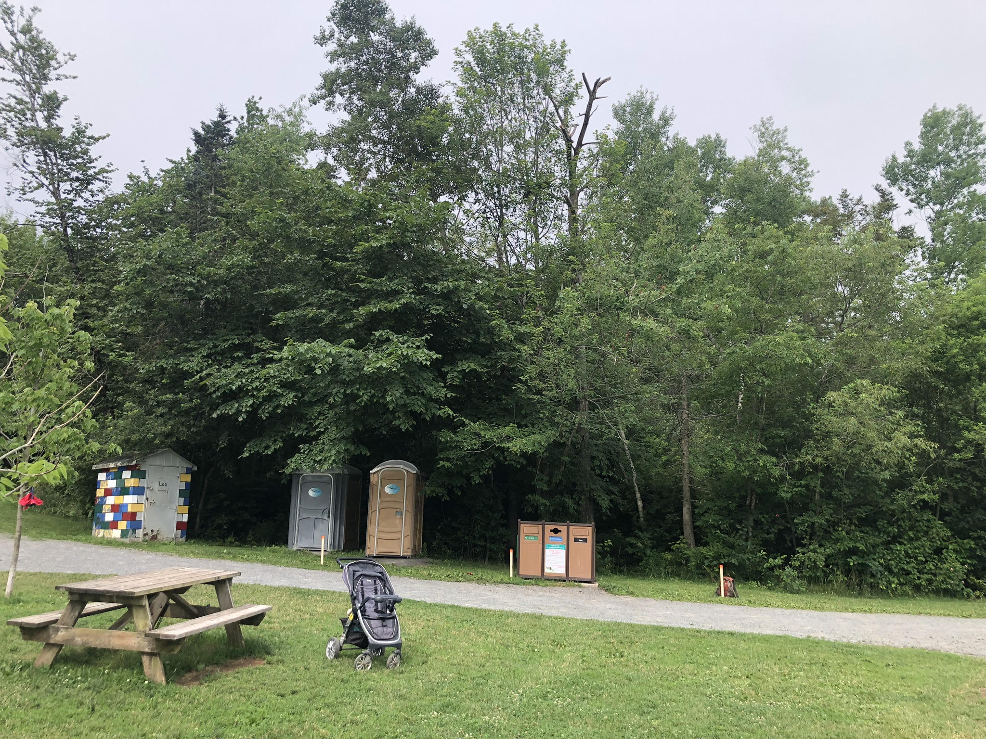
Existing conditions
Current:
No change room facility
Portable toilets
Limited accessibility
Limited shade

Slide 5
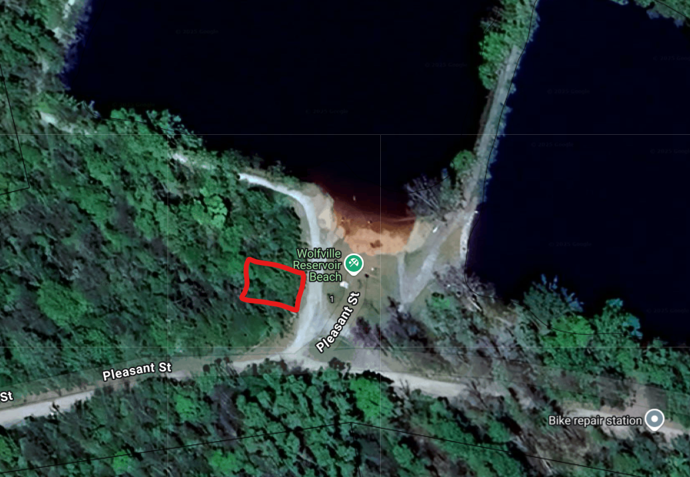
Proposed washroom
Location:
Above beach, next to the open grassy area
Fully accessible facility
Covered roof / shade
Avoids volunteer invasive species work, and can contribute to native planting

Slide 6
Project development
Considered for many years
Design/Build RFP tender process was considered (early 2025)
Standing Offer for General Contracting services – COG Construction
Design was developed with staff, building official and contractors
  2 washrooms (1 accessible)
  3 change rooms
  Outside rinse off tap
  Information bulletin board
  500 sq feet of covered shade area
  Lighting
  Security measures (TBD)
  Metal roof
  Timber frame roof structure
  Wood board and batten siding

Slide 7
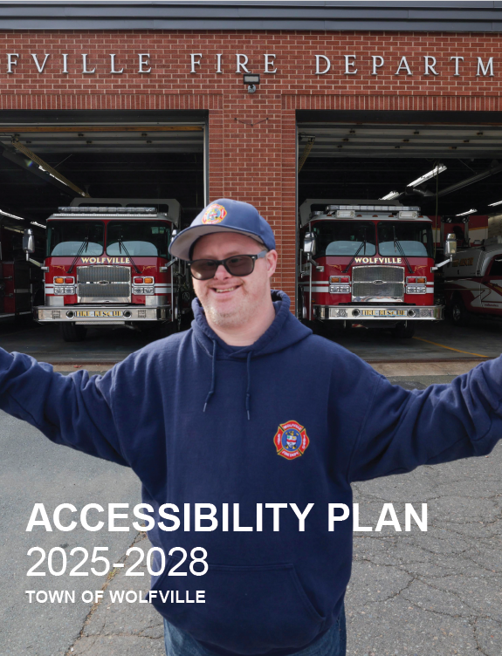
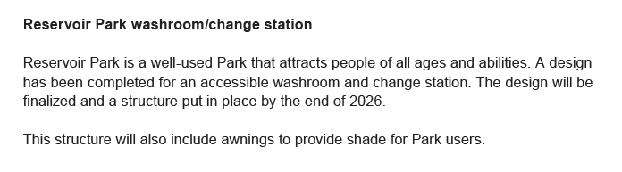
Accessibility Plan:
New facility accessibility goals:
National Building Code accessibility standards
CSA accessibility standards

Slide 8
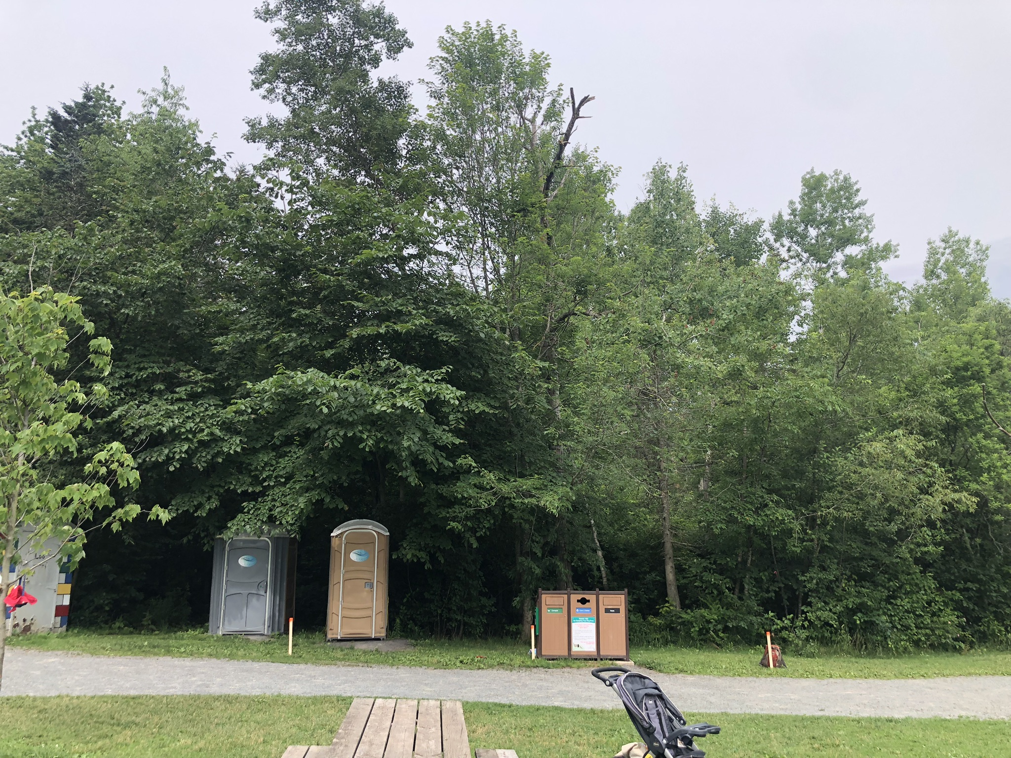
Proposed siting

Slide 9
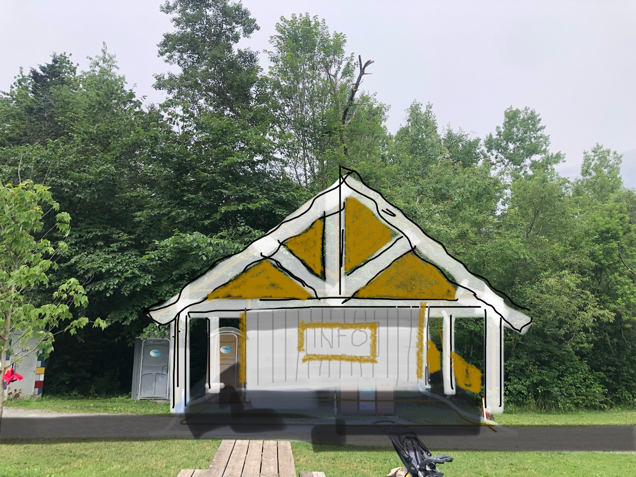
Proposed siting

Slide 10
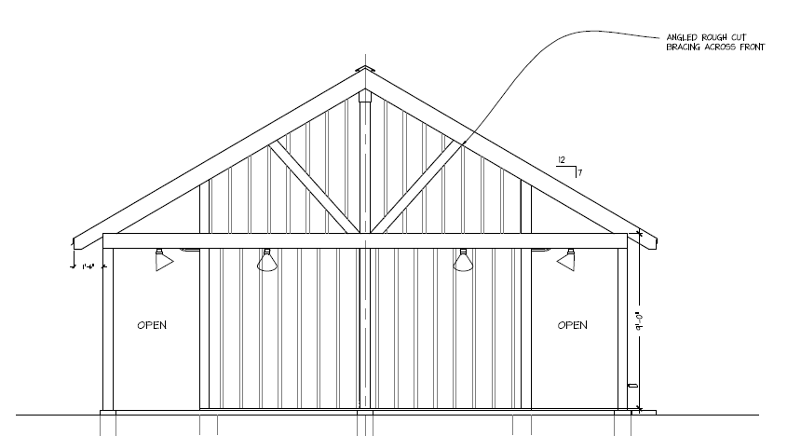
East elevation

Slide 11
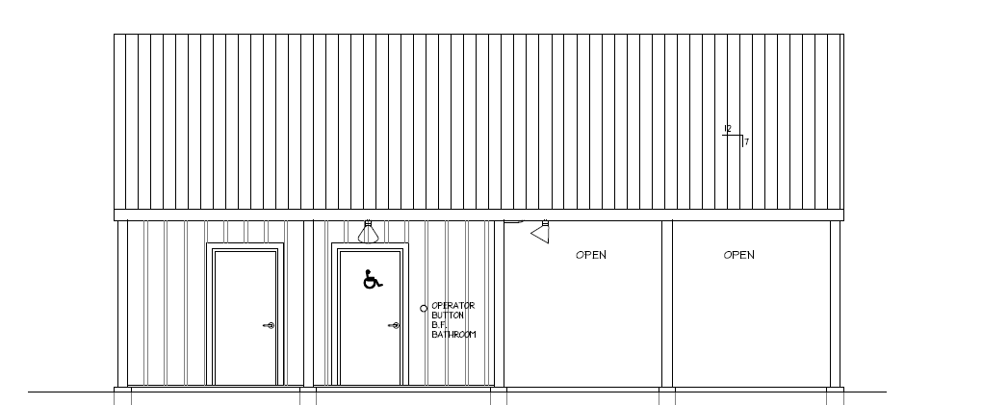
South elevation

Slide 12
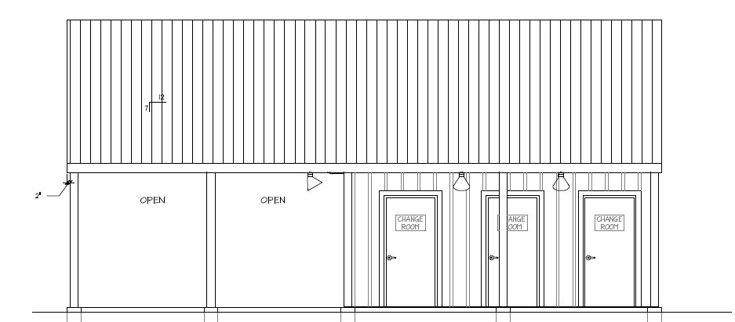
West elevation

Slide 13
Next Steps
Council decision – move forward with proposed $70,000 increase
Construction could begin as early as next week (timeline 45-50 days)
  ~ mid Sept completion
  $228,000 (including tax)
  Park disruption and fenced off area
  No park closure, but active construction site signage/messaging required
Services to be installed by Town Public Works
  Sewer pump station – connecting to Pleasant St
  Water connection (within the park)
  Power connection (within the park)

Slide 14
Proposed Motion
That Council approves the budget increase for the Reservoir Park washroom project from $205,000 to $275,000.

